Slide 1
Rate My Landlord
Rate My Landlord
By: Jake Medica, Ryan Chakov, Ronan Mansour, Linda Schnabel, Sim Sharma, Charles Tran

Slide 2

Double Standards.
Information given to Landlords
Full Name
Age
References from past landlords
Social Security Number
Gender
Ethnicity
Education
Income
Job Status
Credit History
Eviction History
Criminal History
Information given to Tenants
First name
Work phone number
Details on how to submit payments

Slide 3
The Issue
Students face exploitative practices, poor living conditions, and limited accountability from poor landlords

Slide 4
Are reviews helpful?
For Tenants
98% of consumers feel that reviews are essential when making purchase decisions.[5]
79% of consumers specifically seek out websites with product reviews. [5]
86% of consumers don’t buy products online without reading reviews. [5]
For Landlords
50% of consumers trust reviews as much as personal recommendations from friends and family [3]
270% higher likelihood of being purchased than without reviews. [2]
18% increase in sales for a product that has reviews (Both Positive and Negative). [1]

Slide 5
Requirements
User Friendly Site Design
Comprehensive and Cumulative Reviews for:
Landlords
Areas/Neighborhood
User privacy secured through anonymous reviews
Landlords are allowed access to their profile’s reviews
Landlords are given the ability to upload
Certification of Rental Registration [10]
HACP Training Courses [10]
Two Factor verification through Pitt’s Duo Mobile Login System

Slide 6
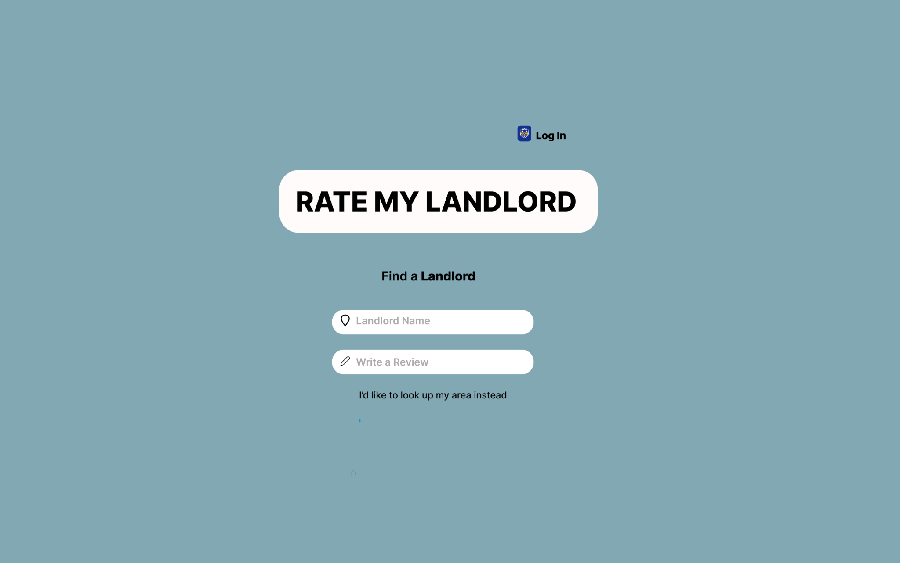

Slide 7
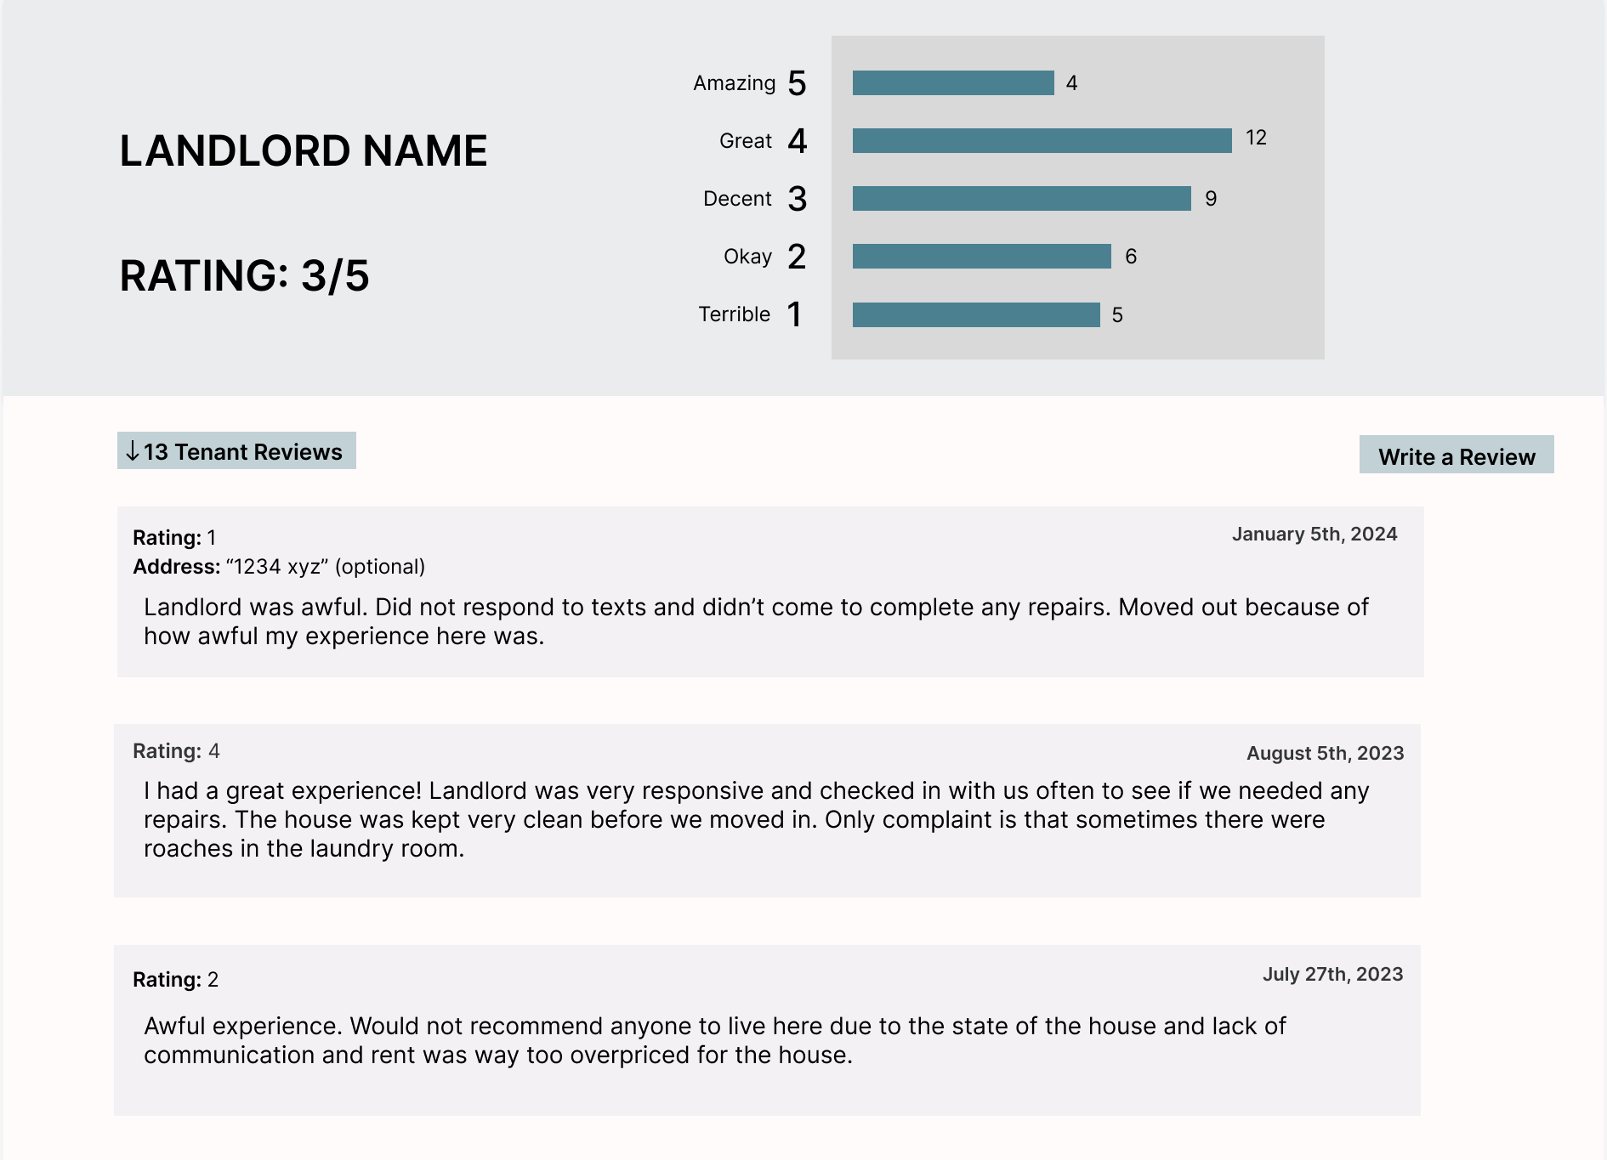

Slide 8
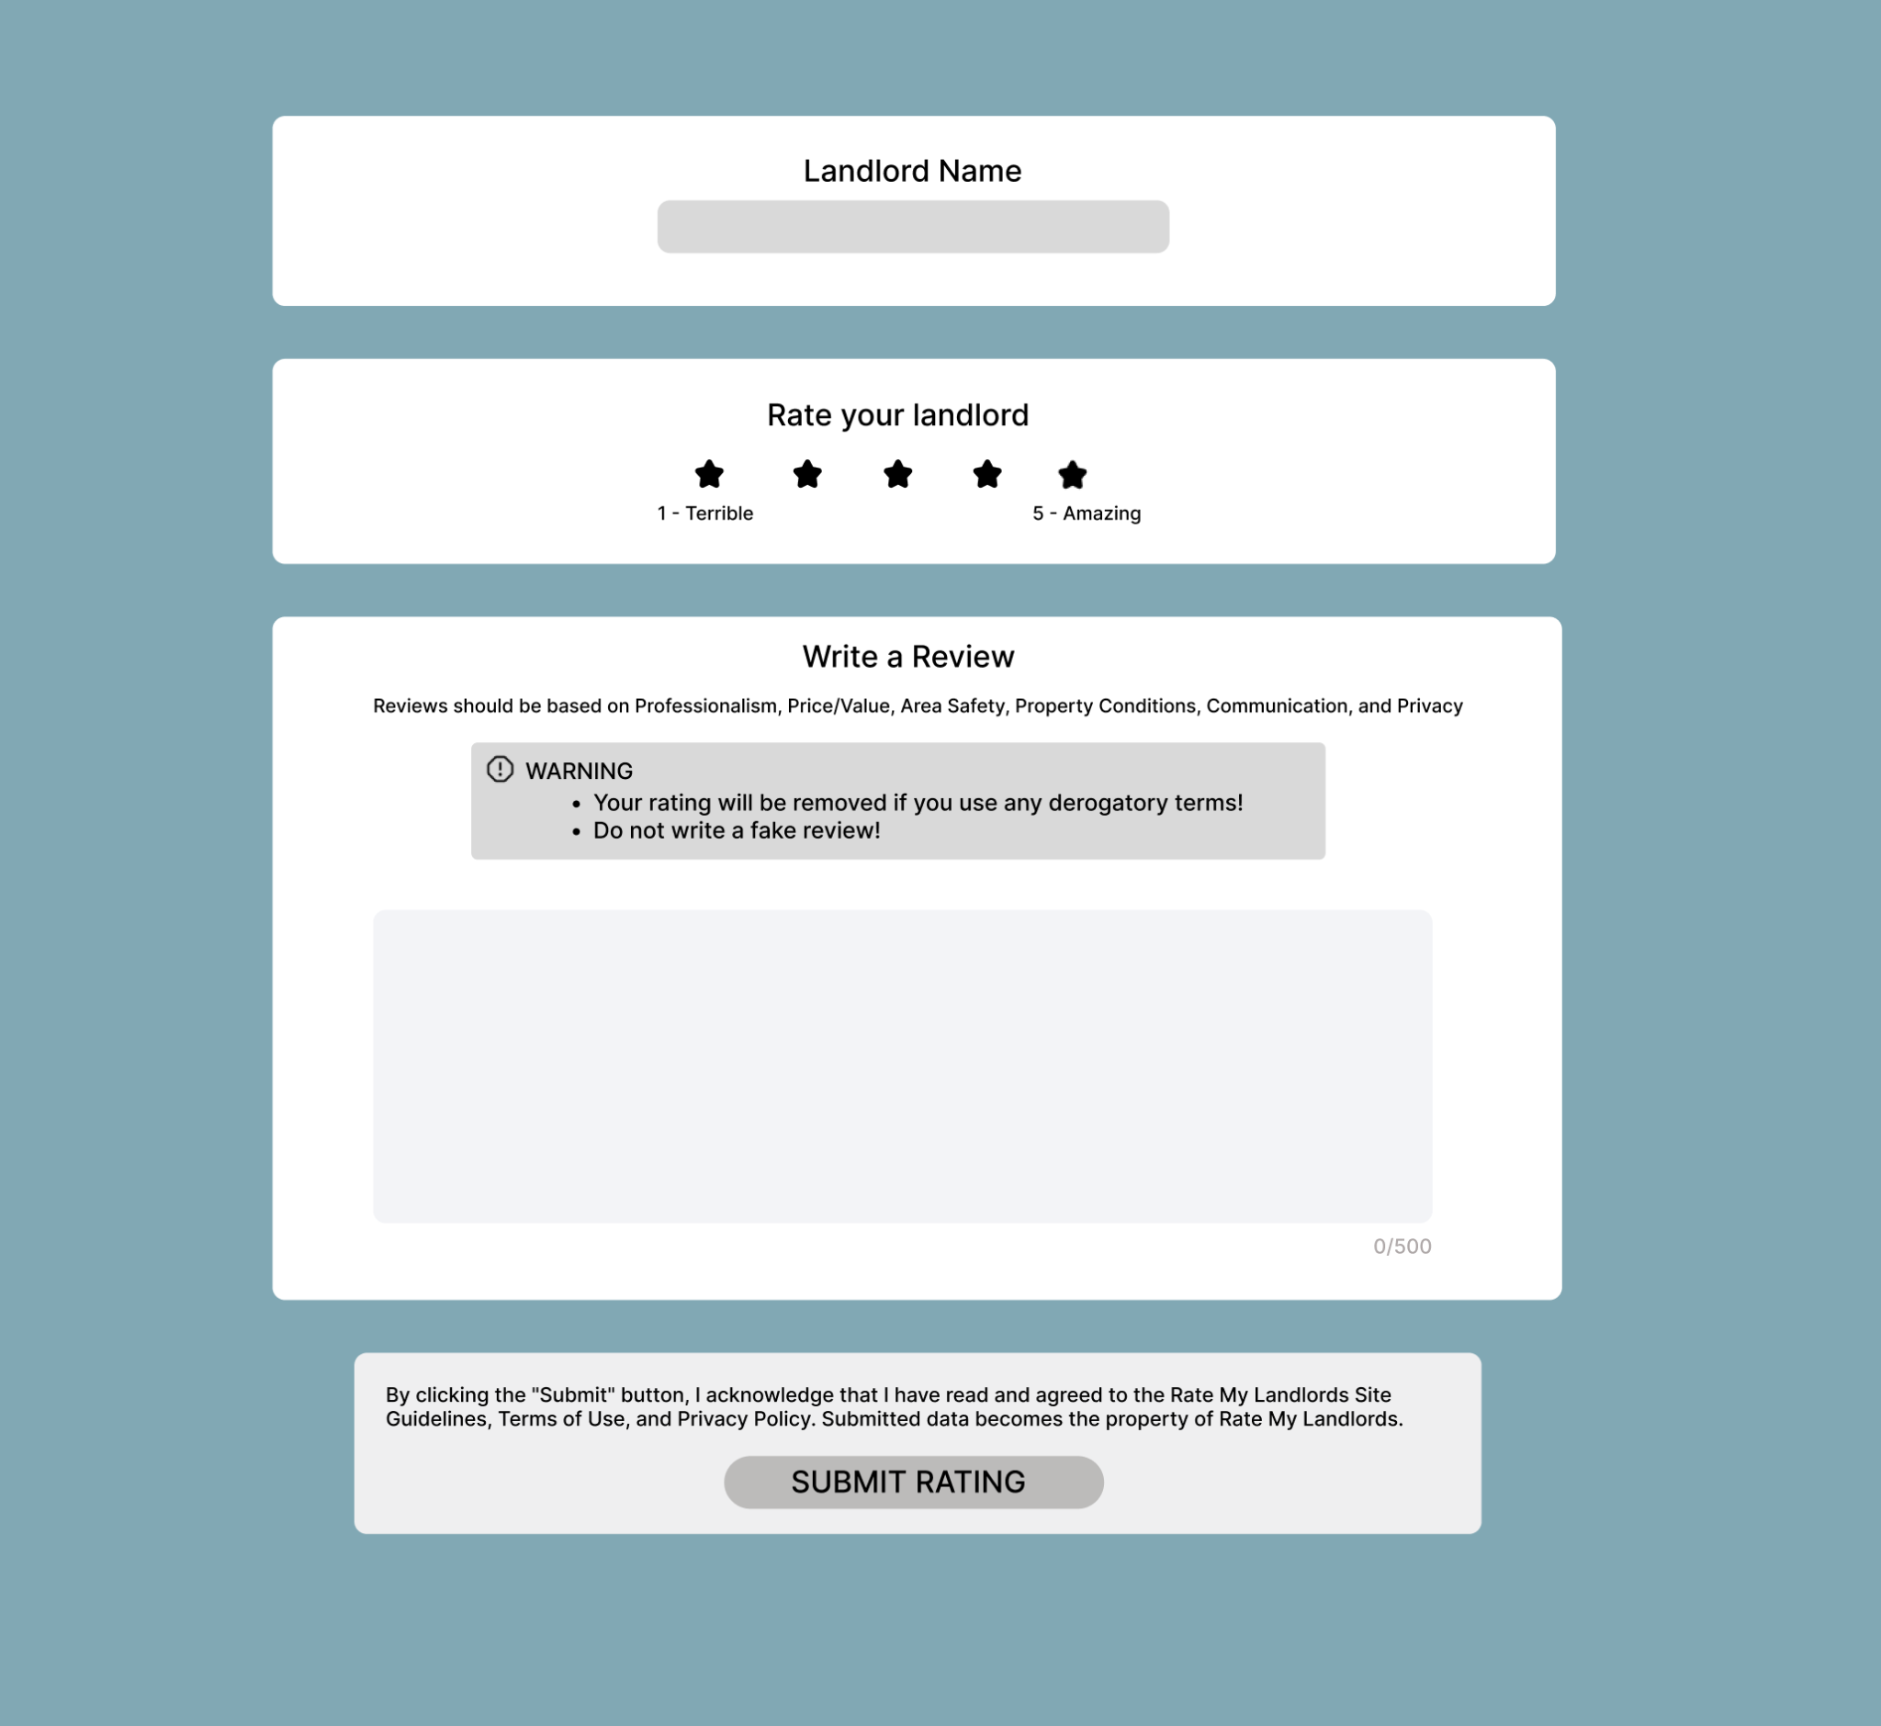

Slide 9
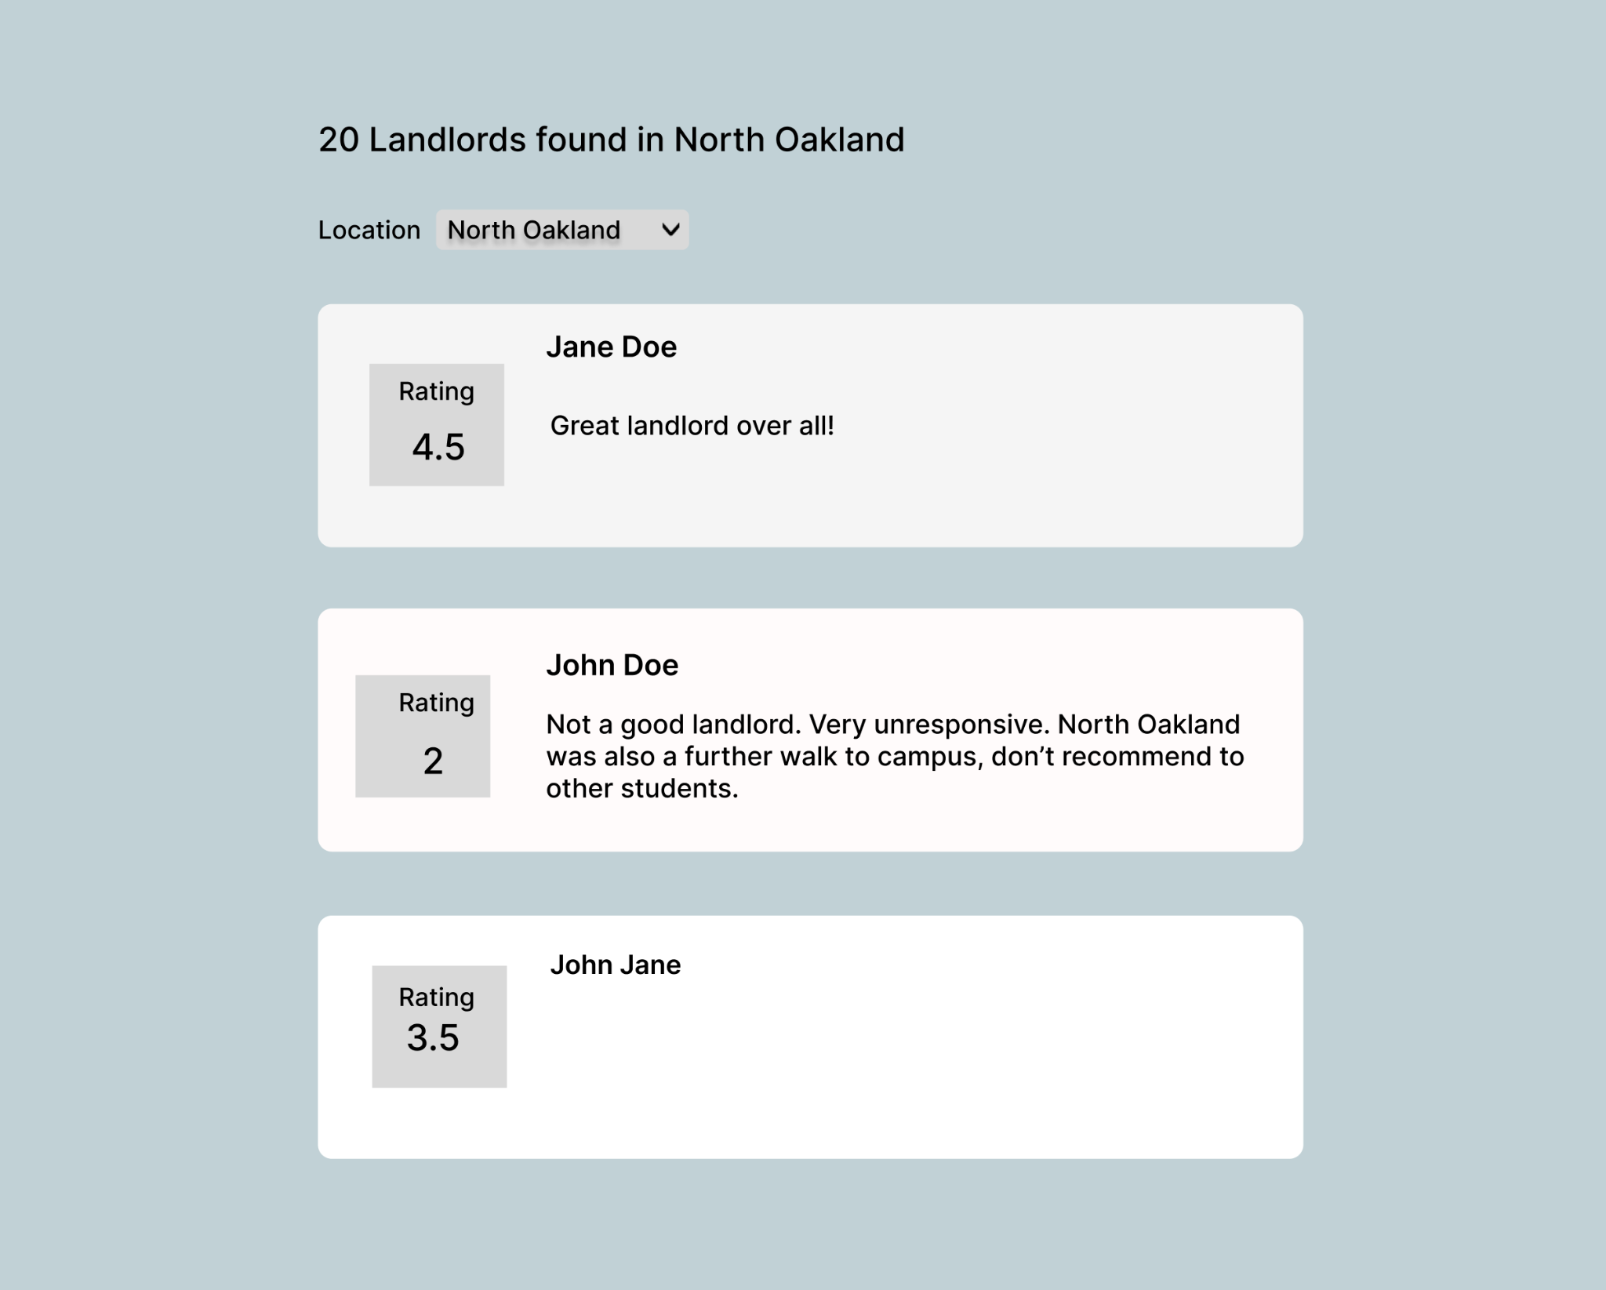

Slide 10


Benefit to stakeholders
[6]
[7]
University’s reputation improves as a good campus for student living
Parents feel at ease knowing their child lives in a safe area

Slide 11

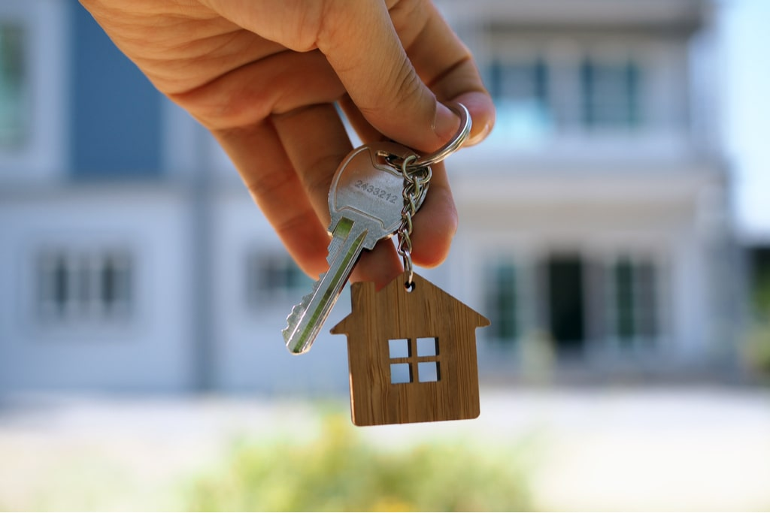
Benefit to stakeholders
[8]
[9]
Students will have a much easier time finding quality housing
Landlords can improve their standing and attract more business

Slide 12

So What?
Students living on campus sophomore year are more likely to have a higher cumulative GPA than students living off campus
- University of Pittsburgh [4]

Slide 13
References
[1] Loiselle, Mia. “3 Statistics That Show How Customer Reviews Influence Consumers.” Dixa, 7 July 2023, www.dixa.com/blog/3-important-statistics-that-show-how-reviews-influence-consumers/.
[2] Mehta, Jimit. “The Impact of Customer Reviews on Growth.” Abmatic AI, 18 Nov. 2023, abmatic.ai/blog/impact-of-customer-reviews-on-growth.
[3] Paget, Sammy. “Local Consumer Review Survey 2024: Trends, Behaviors, and Platforms Explored.” BrightLocal, 6 Mar. 2024, www.brightlocal.com/research/local-consumer-review-survey/.
[4] “Panther Central.” Reasons to Live on Campus as an Upper-Class Student | Panther Central | University of Pittsburgh, www.pc.pitt.edu/reasons-live-campus-upper-class-student. Accessed 14 Apr. 2024.
[5] “Survey: The Ever-Growing Power of Reviews.” PowerReviews, 12 Nov. 2022, www.powerreviews.com/power-of-reviews-survey-2021/.
[6] “University of Pittsburgh.” Oakland, Pittsburgh | Pennsylvania’s Global Center, Oakland Business Improvement District, oaklandpittsburgh.com/businesses/university-of-pittsburgh. Accessed 15 Apr. 2024.
[7] Vera, Amir, and Andrea Diaz. “Inspiring Photo Shows College Grad Standing in the Fruit Fields Where Her Immigrant Parents Work.” CNN, Cable News Network, 28 May 2019, www.cnn.com/2019/05/26/us/graduation-photo-honors-immigrant-parents-trnd/index.html.
[8] “What Is College Life Like?” IvyWise, 5 May 2023, www.ivywise.com/blog/what-is-college-life-like/.
[9] Scott, Marin. “12 Steps to Renting out a House for the First Time.” Avail, 11 Apr. 2024, www.avail.co/education/articles/8-steps-for-renting-out-a-house-for-the-first-time.
[10] “Rental Registration.” City of Pittsburgh., pittsburghpa.gov/pli/rental-registration. Accessed 9 Apr. 2024.
[11] “HACP, County Housing Authority Team up to Host Landlord Training Programs.” Housing Authority of the City of Pittsburgh, 30 Nov. 2018, hacp.org/hacp-county-housing-authority-team-up-to-host/.

